Slide 1
UPPER SIXTH ARTS
GEOGRAPHY
Further Study 1: Contrast in Development within Cameroon
Contrast in Development within Cameroon
Notes:
Good morning, class, and welcome to our geography lesson. I am your geography teacher, Mr Kamdem. Today we are starting Further Study 1: Contrast in Development within Cameroon.

Slide 2
CLASS INFO
Class, Chapter and Duration
Class | Upper Sixth Arts
Chapter | Module 7: Understanding and managing contemporary environmental and development issues
Duration | 2 periods (2 × 50 minutes)
Notes:
This lesson is for Upper Sixth Arts. It belongs to Module 7: Understanding and managing contemporary environmental and development issues. We shall need 2 periods to cover it.

Slide 3
IDENTIFICATION
Lesson Identification
Topic | Geography of Cameroon
Sub-topic | Regional Development and Inequality
Lesson | Further Study 1: Contrast in Development within Cameroon
Notions / Concepts | Regional inequality, core, periphery, backwash, spread effects, lagging region.
Syllabus focus | Models of regional inequality (Friedmann, Myrdal); prosperous and lagging regions (case study: Coastal lowlands versus Adamawa); indicators; factors; measures; difficulties.
Competence | Learners are able to compare regions of Cameroon and propose ways to reduce inequality.
Notes:
Our topic is Geography of Cameroon, and the sub-topic is Regional Development and Inequality. The key notions we shall use today are: regional inequality, core, periphery, backwash, spread effects, lagging region. At the end, you should be able to do this: learners are able to compare regions of Cameroon and propose ways to reduce inequality.

Slide 4

HOMEWORK CORRECTION
Correction of the Homework
Question (Lesson 14: Aid and Interdependence):
Find an aid project in your region and write who funds it and what it does.
Notes:
Before we start the new lesson, let us correct the homework I gave you at the end of Lesson 14: Aid and Interdependence. The question was: Find an aid project in your region and write who funds it and what it does. Take out your exercise books.

Slide 5
HOMEWORK CORRECTION
Correction: Possible Answer
Example: a borehole programme funded by UNICEF or Japan (JICA) supplies clean water to villages; the World Food Programme gives food to refugees in the Far North.
Notes:
Here is a good answer. Example: a borehole programme funded by UNICEF or Japan (JICA) supplies clean water to villages; the World Food Programme gives food to refugees in the Far North. Compare it with your own answer and correct your work in red.

Slide 6
LESSON PLAN
Lesson Plan
Correction of the homework
Objectives and recall
Real-life situation and action to take
Learning activities
Board summary
Evaluation, remediation and homework
Notes:
Here is the plan of our lesson today. First, we shall correct the homework. Then we shall look at the objectives and recall what you already know. After that, we shall study a situation from real life and the action to take, and do the learning activities. Finally, we shall copy the board summary, do the evaluation and the remediation, and I will give you the homework.

Slide 7
OBJECTIVES
Objectives
By the end of this lesson, you should be able to:
Recall the models of Myrdal and Friedmann.
Compare a prosperous and a lagging region with indicators.
Notes:
Take your time to copy this part; we will continue together.

Slide 8
OBJECTIVES
Objectives (continued)
Explain the causes and measures of regional inequality.
Notes:
By the end of this lesson, you should be able to do three things. Number 1: recall the models of Myrdal and Friedmann. Number 2: compare a prosperous and a lagging region with indicators. Number 3: explain the causes and measures of regional inequality.

Slide 9
PREVIOUS KNOWLEDGE
Previous Knowledge
Douala and Yaoundé are the largest towns.
Population density differs between regions.
Notes:
Let us first remember what you already know. Douala and Yaoundé are the largest towns. Population density differs between regions. Keep this in mind, because we shall build on it today.

Slide 10
REAL-LIFE SITUATION
Situation in Real Life
Young people from Adamawa and the Far North move to Douala to find work. Douala has the port, factories and many schools, while some villages in Adamawa have no road or electricity.
Notes:
Listen carefully to this situation from real life. Young people from Adamawa and the Far North move to Douala to find work. Douala has the port, factories and many schools, while some villages in Adamawa have no road or electricity. Think about it, because I am going to ask you some questions.

Slide 11
REAL-LIFE SITUATION
Situation: Question 1
What is the problem in the situation?
Notes:
Question 1: What is the problem in the situation? Think for a moment, then raise your hand to answer.

Slide 12
REAL-LIFE SITUATION
Answer
Development is unequal between regions.
Notes:
Good. Development is unequal between regions.

Slide 13
REAL-LIFE SITUATION
Situation: Question 2
Which region is prosperous?
Notes:
Question 2: Which region is prosperous? Think for a moment, then raise your hand to answer.

Slide 14
REAL-LIFE SITUATION
Answer
The Coastal lowlands (Douala).
Notes:
Good. The Coastal lowlands (Douala).

Slide 15
REAL-LIFE SITUATION
Situation: Question 3
Which region is lagging?
Notes:
Question 3: Which region is lagging? Think for a moment, then raise your hand to answer.

Slide 16
REAL-LIFE SITUATION
Possible Answer
Adamawa (and the Far North).
Notes:
Good. Adamawa (and the Far North).

Slide 17
ACTION TO TAKE
Action to Take
Support projects that develop the lagging regions.
Notes:
From this situation, the action we are working towards in this lesson is the following: support projects that develop the lagging regions.

Slide 18
JUSTIFICATION
Justification of the Lesson
This further study helps us to understand and reduce inequality inside Cameroon.
Notes:
Why is this lesson important for you? This further study helps us to understand and reduce inequality inside Cameroon.

Slide 19
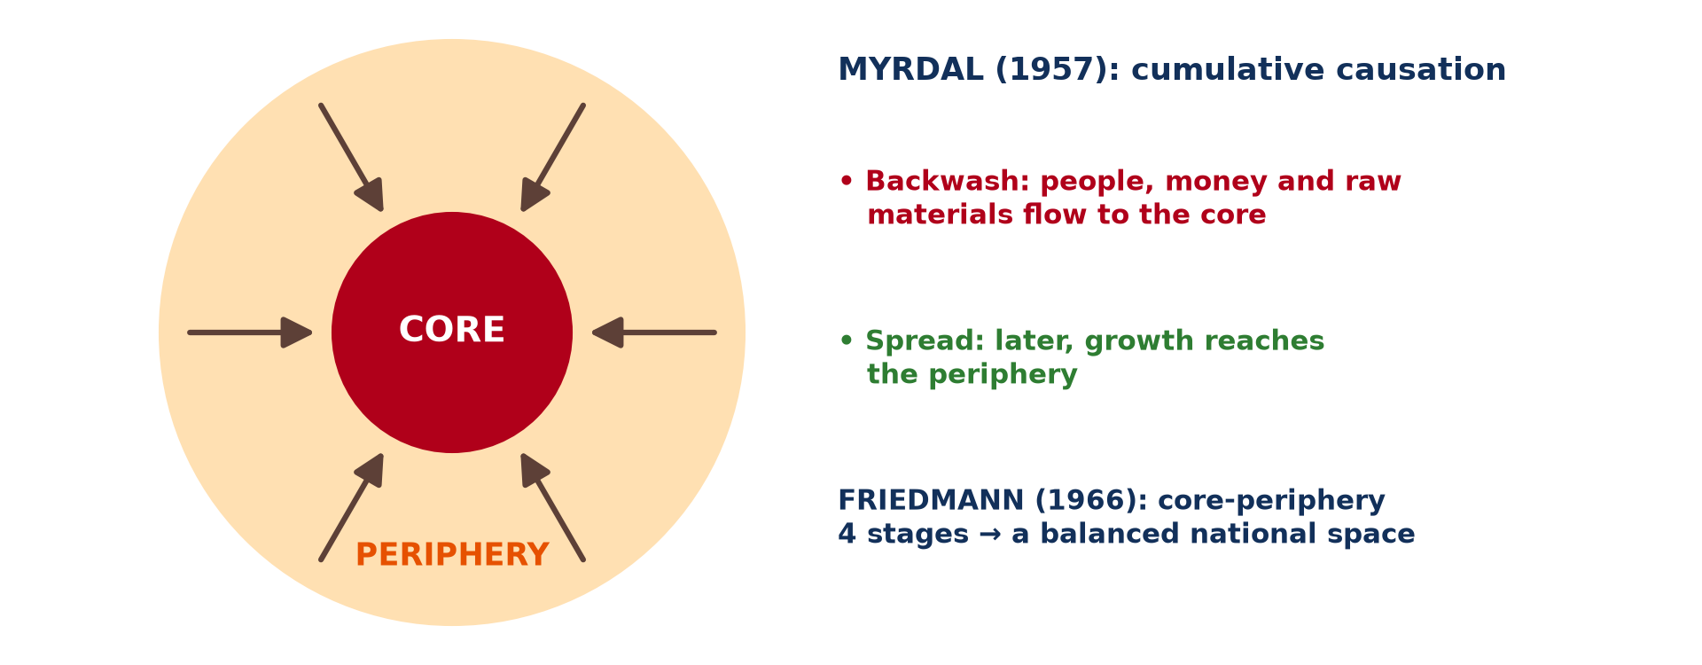
1. MODELS OF REGIONAL INEQUALITY
Activity 1
Core and periphery.
Notes:
Activity 1. Look carefully at this diagram: core and periphery. Observe every detail before I ask the question.

Slide 20
1. MODELS OF REGIONAL INEQUALITY
Activity 1: Question
Explain Myrdal's backwash effect.
Notes:
Here is the question for Activity 1: Explain Myrdal's backwash effect. Take one minute to think and write your answer in your rough notebook.

Slide 21
1. MODELS OF REGIONAL INEQUALITY
Activity 1: Answer
People, money and raw materials flow from the periphery to the core, which grows richer.
Notes:
Let us check the answer together. People, money and raw materials flow from the periphery to the core, which grows richer.

Slide 22
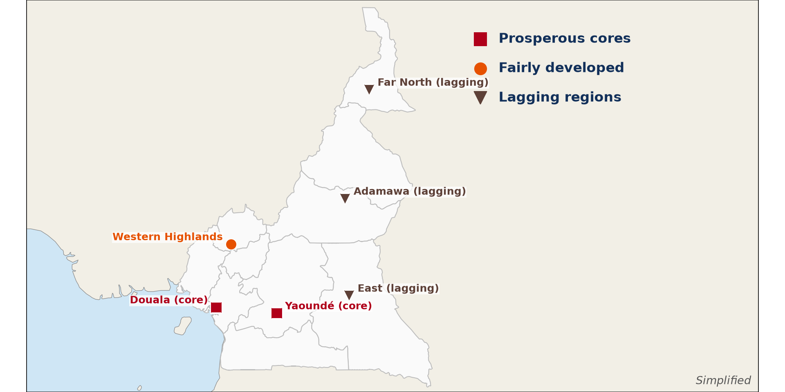
2. CONTRASTING REGIONS
Activity 2
Prosperous and lagging regions.
Notes:
Activity 2. Look carefully at this diagram: prosperous and lagging regions. Observe every detail before I ask the question.

Slide 23
2. CONTRASTING REGIONS
Activity 2: Question
Name two prosperous and two lagging regions.
Notes:
Here is the question for Activity 2: Name two prosperous and two lagging regions. Take one minute to think and write your answer in your rough notebook.

Slide 24
2. CONTRASTING REGIONS
Activity 2: Answer
Prosperous: Littoral, Centre. Lagging: Adamawa, East (also Far North).
Notes:
Let us check the answer together. Prosperous: Littoral, Centre. Lagging: Adamawa, East (also Far North).

Slide 25
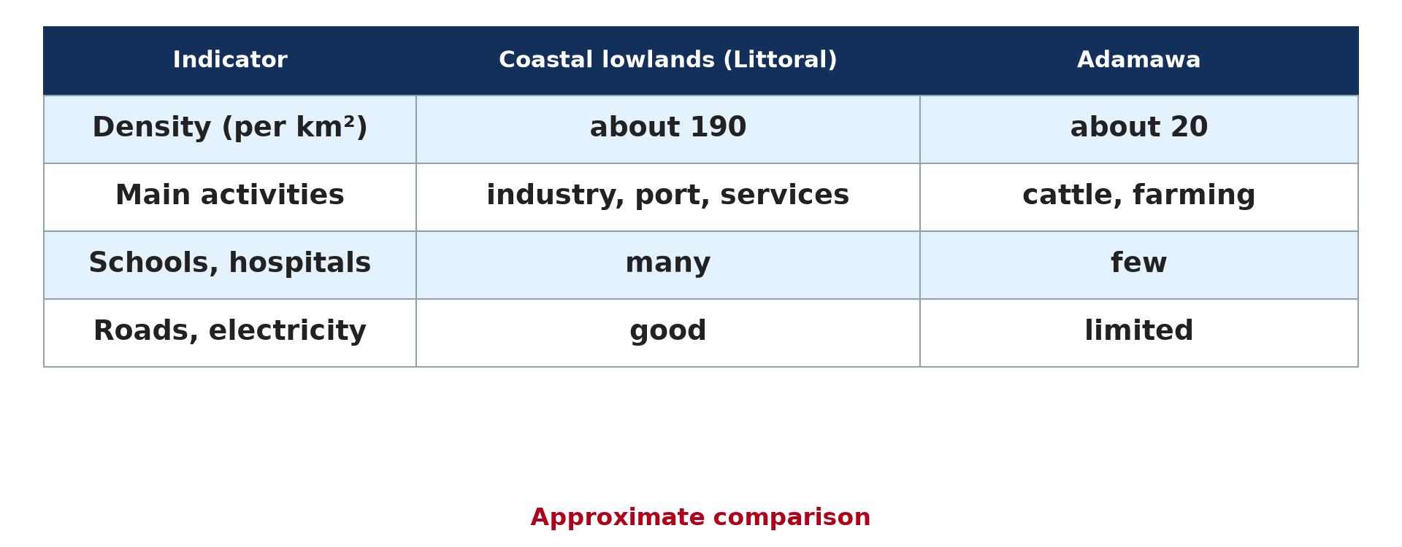
2. INDICATORS
Activity 3
Coastal lowlands and Adamawa compared.
Notes:
Activity 3. Look carefully at this diagram: coastal lowlands and Adamawa compared. Observe every detail before I ask the question.

Slide 26
2. INDICATORS
Activity 3: Question
Give three indicators that show the difference.
Notes:
Here is the question for Activity 3: Give three indicators that show the difference. Take one minute to think and write your answer in your rough notebook.

Slide 27
2. INDICATORS
Activity 3: Answer
Population density, schools and hospitals, roads and electricity.
Notes:
Let us check the answer together. Population density, schools and hospitals, roads and electricity.

Slide 28

3. FACTORS
Activity 4
Douala, the economic capital.
Notes:
Activity 4. Look carefully at this picture: douala, the economic capital. Observe every detail before I ask the question.

Slide 29
3. FACTORS
Activity 4: Question
Why is the coastal region more developed?
Notes:
Here is the question for Activity 4: Why is the coastal region more developed? Take one minute to think and write your answer in your rough notebook.

Slide 30
3. FACTORS
Activity 4: Answer
Port, industries, investment and colonial history concentrated there.
Notes:
Let us check the answer together. Port, industries, investment and colonial history concentrated there.

Slide 31

4. MEASURES AND DIFFICULTIES
Activity 5
A poor road in a lagging region.
Notes:
Activity 5. Look carefully at this picture: a poor road in a lagging region. Observe every detail before I ask the question.

Slide 32
4. MEASURES AND DIFFICULTIES
Activity 5: Question
Give two measures to reduce regional inequality.
Notes:
Here is the question for Activity 5: Give two measures to reduce regional inequality. Take one minute to think and write your answer in your rough notebook.

Slide 33
4. MEASURES AND DIFFICULTIES
Activity 5: Answer
Decentralisation with regional budgets and building roads and schools in lagging regions.
Notes:
Let us check the answer together. Decentralisation with regional budgets and building roads and schools in lagging regions.

Slide 34
BOARD SUMMARY
Board Summary
Topic: Geography of Cameroon
Sub-topic: Regional Development and Inequality
Further Study 1: Contrast in Development within Cameroon
Notes:
Now we are going to copy the board summary. Write the title and the headings neatly in your notebooks. I will give you enough time for each slide, so do not rush.

Slide 35
BOARD SUMMARY
DEFINITIONS
The key terms of this lesson are defined as follows:
Regional inequality: It is the difference in development between the regions of a country. It shows in incomes, services and jobs.
Notes:
Let us copy the definitions. The key terms of this lesson are defined as follows. On this slide we have Regional inequality. Write each point on a new line, with the key term first, and explain it in your own words when we revise. When you finish, we go to the next slide.

Slide 36
BOARD SUMMARY
DEFINITIONS (continued)
Core and periphery: The core is a rich, developed region, and the periphery is a poorer region around it. A lagging region is one that grows more slowly than the rest of the country.
Notes:
We continue with the definitions. On this slide we have Core and periphery. Write each point on a new line, with the key term first, and explain it in your own words when we revise.

Slide 37
BOARD SUMMARY
1. Models of Regional Inequality
Two models explain regional inequality:
Myrdal (cumulative causation): A region with an early advantage attracts investment, labour and capital, so it grows faster. Backwash effects drain the periphery, but spread effects later carry growth outward.
Notes:
Let us copy Models of Regional Inequality. Two models explain regional inequality. On this slide we have Myrdal (cumulative causation). Write each point on a new line, with the key term first, and explain it in your own words when we revise. When you finish, we go to the next slide.

Slide 38
BOARD SUMMARY
1. Models of Regional Inequality (continued)
Friedmann (core-periphery): Development passes from a pre-industrial stage to a strong core with a weak periphery. Growth then spreads to sub-cores until the country becomes integrated.
Notes:
We continue with Models of Regional Inequality. On this slide we have Friedmann (core-periphery). Write each point on a new line, with the key term first, and explain it in your own words when we revise.

Slide 39
BOARD SUMMARY
1. Models of Regional Inequality
Illustration: core and periphery
Notes:
Now draw this illustration in your notebook: core and periphery. Give it a title and label it clearly.

Slide 40
BOARD SUMMARY
2. Prosperous and Lagging Regions
Cameroon has prosperous and lagging regions:
Coastal lowlands (prosperous): The Littoral and South-West have the port of Douala, industries, plantations and oil. Incomes, schools and hospitals are above the national average.
Notes:
Let us copy Prosperous and Lagging Regions. Cameroon has prosperous and lagging regions. On this slide we have Coastal lowlands (prosperous). Write each point on a new line, with the key term first, and explain it in your own words when we revise. When you finish, we go to the next slide.

Slide 41
BOARD SUMMARY
2. Prosperous and Lagging Regions (continued)
Adamawa (lagging): Adamawa has a low population, few industries and poor roads. Incomes, school enrolment and access to services are below average.
Notes:
We continue with Prosperous and Lagging Regions. On this slide we have Adamawa (lagging). Write each point on a new line, with the key term first, and explain it in your own words when we revise. When you finish, we go to the next slide.

Slide 42
BOARD SUMMARY
2. Prosperous and Lagging Regions (continued)
Indicators: Income, literacy, access to water and electricity and doctors per person show the contrast. Road density and industrial jobs also differ.
Notes:
We continue with Prosperous and Lagging Regions. On this slide we have Indicators. Write each point on a new line, with the key term first, and explain it in your own words when we revise.

Slide 43
BOARD SUMMARY
2. Prosperous and Lagging Regions
Illustration: prosperous and lagging regions
Notes:
Now draw this illustration in your notebook: prosperous and lagging regions. Give it a title and label it clearly.

Slide 44
BOARD SUMMARY
3. Factors, Measures and Difficulties
Regional inequality has factors and can be reduced as follows:
Factors: Natural resources, the port, investment, skilled people and colonial history favour the coast. Remoteness, a long dry season and poor transport slow the north and east.
Notes:
Let us copy Factors, Measures and Difficulties. Regional inequality has factors and can be reduced as follows. On this slide we have Factors. Write each point on a new line, with the key term first, and explain it in your own words when we revise. When you finish, we go to the next slide.

Slide 45
BOARD SUMMARY
3. Factors, Measures and Difficulties (continued)
Measures: The state builds roads, dams and schools in lagging regions and decentralises power. Development agencies such as MIDIMA in Adamawa and incentives for investors help.
Notes:
We continue with Factors, Measures and Difficulties. On this slide we have Measures. Write each point on a new line, with the key term first, and explain it in your own words when we revise. When you finish, we go to the next slide.

Slide 46
BOARD SUMMARY
3. Factors, Measures and Difficulties (continued)
Difficulties: Lack of money, corruption and insecurity slow these projects. Investors still prefer the coast.
Notes:
We continue with Factors, Measures and Difficulties. On this slide we have Difficulties. Write each point on a new line, with the key term first, and explain it in your own words when we revise.

Slide 47
FORMATIVE EVALUATION
Evaluation 1
Compare the Coastal lowlands and Adamawa with two indicators.
Notes:
Now let us check what you have understood. Question 1: Compare the Coastal lowlands and Adamawa with two indicators. Answer in your exercise book.

Slide 48
FORMATIVE EVALUATION
Expected Answer
Density: about 190 vs 20 per km²; many vs few schools and hospitals.
Notes:
The expected answer is: density: about 190 vs 20 per km²; many vs few schools and hospitals. If you got it right, well done.

Slide 49
FORMATIVE EVALUATION
Evaluation 2
Give two causes and two measures of regional inequality.
Notes:
Now let us check what you have understood. Question 2: Give two causes and two measures of regional inequality. Answer in your exercise book.

Slide 50
FORMATIVE EVALUATION
Expected Answer
Causes: port, investment. Measures: decentralisation, roads.
Notes:
The expected answer is: causes: port, investment. Measures: decentralisation, roads. If you got it right, well done.

Slide 51
REMEDIATION
Remediation
Fill in the blanks:
A rich region is a ______.
A poorer region is the ______.
Flows to the core are ______ effects.
Notes:
For those who need more practice, fill in the blanks in your exercise book. The answers are: number 1, core; number 2, periphery; number 3, backwash.

Slide 52
HOMEWORK
Homework
Compare your region with Douala using three indicators and suggest two projects.
Notes:
For your homework: Compare your region with Douala using three indicators and suggest two projects. We shall correct it at the beginning of our next lesson.

Slide 53
NEXT LESSON
Next Lesson
Our next lesson will be on:
Map Analysis 1: Review of Map Reading Principles
Notes:
Our next lesson will be on Map Analysis 1: Review of Map Reading Principles. Thank you for your attention, and see you next time.

Slide 54
BILINGUAL GAME
Bilingual Game (Jeu Bilingue)
English | Français
Inequality | L'inégalité
Region | La région
Core | Le centre
Periphery | La périphérie
Decentralisation | La décentralisation
Migration | L'exode
Notes:
Let us play the bilingual game. I say a word in English, and you give me the French word. Then we do the reverse.

Slide 55
LOGBOOK
Official Logbook (1/2)
Module / Topic | Geography of Cameroon
Lesson Title | Further Study 1: Contrast in Development within Cameroon
Expected Learning Outcomes | Recall the models of Myrdal and Friedmann. Compare a prosperous and a lagging region with indicators. Explain the causes and measures of regional inequality.
Competence | Learners are able to compare regions of Cameroon and propose ways to reduce inequality.
Notes:
I record this information in the official logbook of the class after the lesson.

Slide 56
LOGBOOK
Official Logbook (2/2)
Matter Taught | DEFINITIONS; Models of Regional Inequality; Prosperous and Lagging Regions; Factors, Measures and Difficulties.
Evaluation | Formative evaluation and remediation exercise.
Homework | Compare your region with Douala using three indicators and suggest two projects.
Enrolment / Present / Absent | ____ / ____ / ____
Achievement | To be completed after the lesson.
Notes:
I complete the second page of the logbook: the matter taught, the evaluation, the homework and the attendance.

Slide 57
TEACHER'S NOTE
Teacher's Note
Timing: Homework correction, plan, objectives 8 min | Recall, situation, action 10 min | 5 activities 30 min | Board summary (copying) 30 min | Evaluation, remediation 10 min | Homework, next lesson 5 min | Logbook 7 min
Without the projector (Activity 1): explain the arrows.
Without the projector (Activity 2): read the map.
Without the projector (Activity 3): compare the columns.
Without the projector (Activity 4): list factors.
Without the projector (Activity 5): suggest projects.
Notes:
This slide is for me, the teacher: it gives the timing of the lesson and what to do if the projector is not available.

Slide 58
REFERENCES
References
National Geography Syllabus, MINESEC/IGE/IP-SS, 2019 — Module 7 (Environment and Development).
Photo, Activity 4: “Douala” by christing-O-, CC BY 2.0, via Flickr (https://www.flickr.com/photos/76187282@N00/7227535754)
Photo, Activity 5: “Cameroon - UN Women's Gender Road Project” by UN Women Gallery, CC BY-NC-ND 2.0, via Flickr (https://www.flickr.com/photos/51431730@N04/40672356003)
Diagrams and animations: drawn for this lesson (Geography Department).
Notes:
These are the references and picture credits used to prepare this lesson.

